Slide 1
AI Agent for Digital Financial Literacy
IBM SKILLSBUILD PROJECT
Presented By:
Student name : Souparnika H
College Name & Department : Bharathiar University & Department of Computer Application

Slide 2
OUTLINE
Problem Statement
Technology used
Wow factor
End users
Result
Conclusion
Git-hub Link
Future scope
IBM Certifications

Slide 3
Problem Statement
Problem Statement:
Users across diverse backgrounds often struggle to understand digital financial tools and fall victim to scams due to limited guidance and language barriers. There's a need for a system that simplifies UPI usage, prevents fraud, and answers financial queries in native languages.
Solution:
An AI Agent powered by Natural Language Processing and Retrieval Augmented Generation retrieves reliable financial content and supports multilingual interaction. It educates users on UPI usage, fraud prevention, budgeting, and more making digital finance accessible and secure using IBM Cloud Lite and IBM Granite models.

Slide 4
Technology used
IBM cloud lite services
Natural Language Processing (NLP)
Retrieval Augmented Generation (RAG)
IBM Granite model

Slide 5
IBM cloud services used
IBM Cloud Watsonx AI Studio
IBM Cloud Watsonx AI runtime
IBM Cloud Agent Lab
IBM Granite foundation model

Slide 6
Wow factors
This AI agent empowers users by making digital finance more accessible, secure, and user friendly. It assists with financial and banking related queries, supports multilingual interaction, and enables users to ask questions in their native language. The agent promotes safe digital transactions, improves budgeting awareness, and guides users in choosing suitable financial schemes with confidence.
Unique features:
Natural language support in multiple regional languages
Step-by-step guidance on using UPI and online banking tools
Scam prevention tips and alerts for suspicious activity
Budget tracking and expense-splitting suggestions
Interest rate comparison across different banks and schemes
Personalized financial education based on user queries

Slide 7
End users
General Public of Urban & Rural Areas
Senior Citizens & First Time Internet Users
Cybersecurity Awareness Programs
People willing to learn about New schemes
Individuals Who Want to Budget Effectively

Slide 8
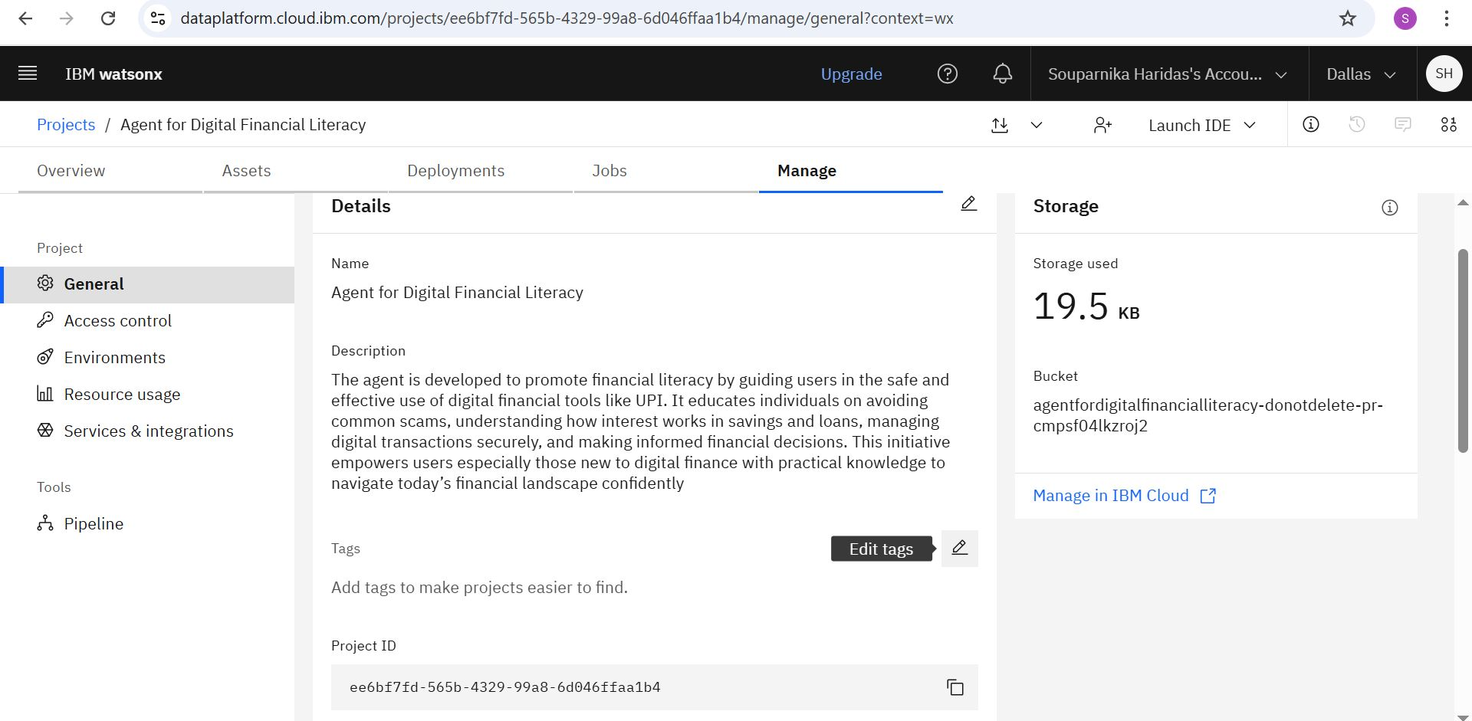
Result Created an ai agent

Slide 9
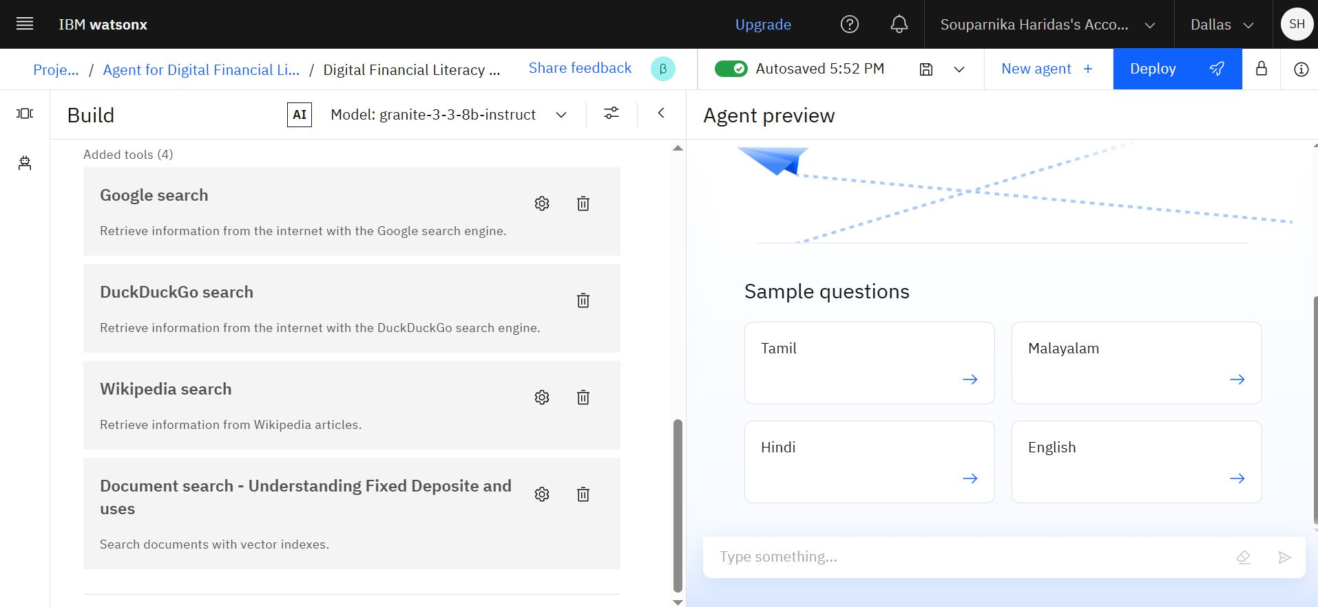
Result WORKED ON DEVELOPING AGENT

Slide 10
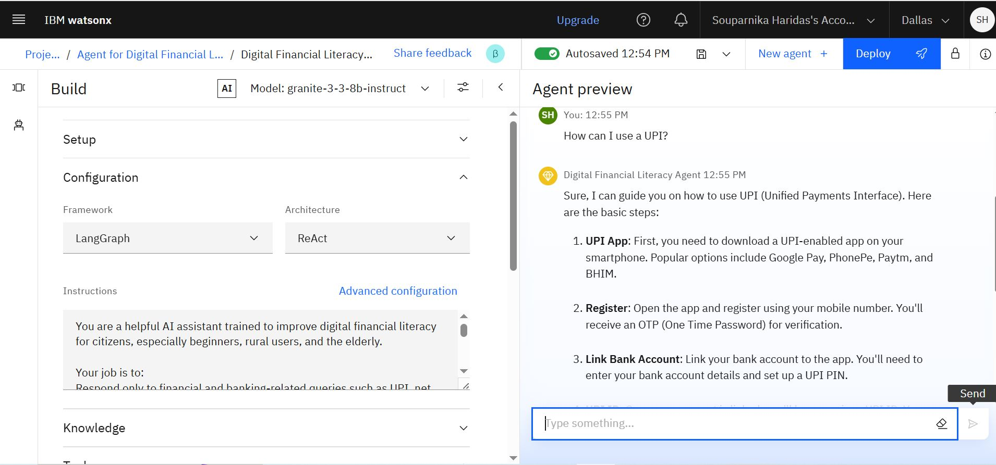
Result ASK AGENT HOW TO USE AN UPI ?

Slide 11
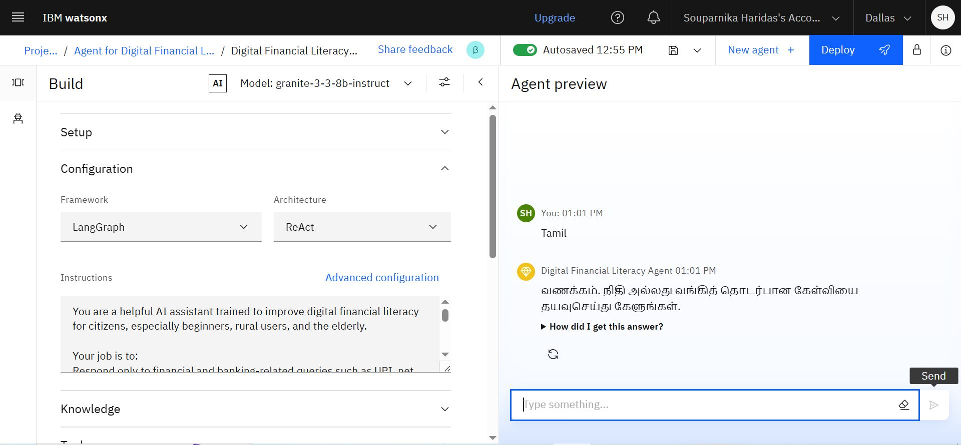
Result MULTI LANGUAGE PREFERENCE

Slide 12
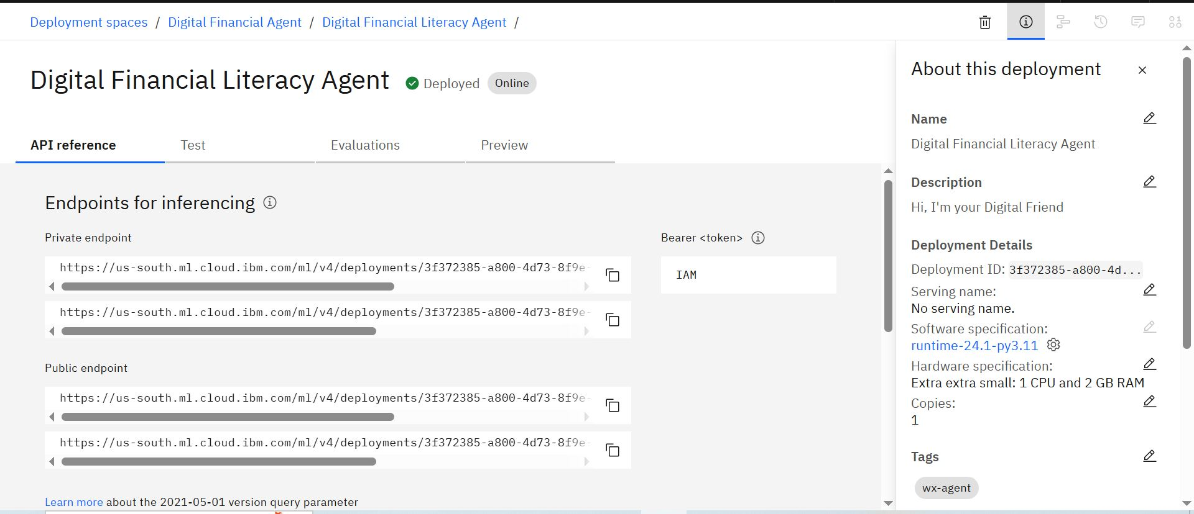
Result DEPLOYED AGENT

Slide 13
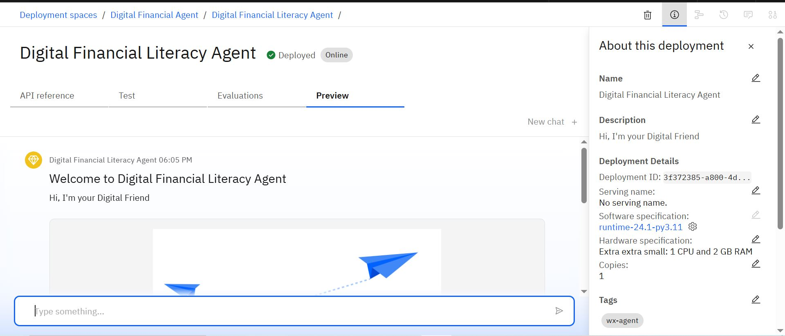
Result PREVIEW OF AGENT

Slide 14
Conclusion
The Digital Financial Literacy AI Agent serves as a powerful and inclusive tool to bridge the financial knowledge gap across diverse user groups.
By offering multilingual support and simplified guidance on banking, budgeting, and safe digital transactions, it empowers individuals to make informed financial decisions.
With its ability to identify scams, suggest schemes, and encourage responsible money management, this agent fosters financial confidence and digital trust, contributing to a more financially literate society.

Slide 15
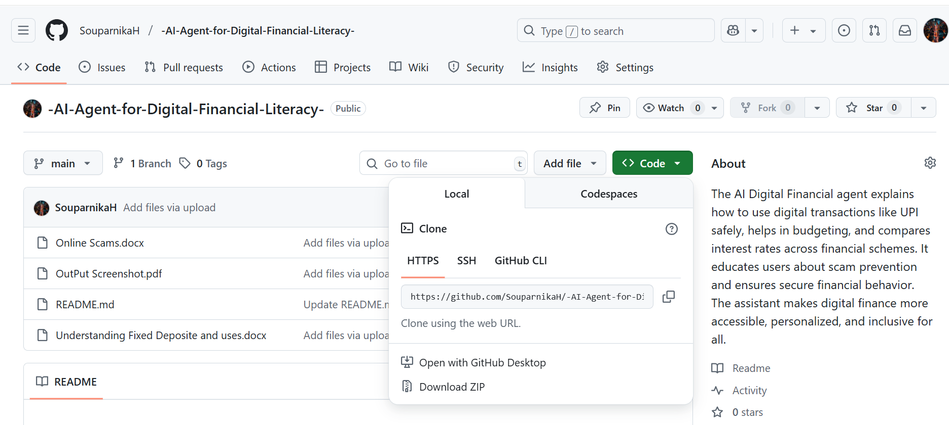
GitHub Link
https://github.com/SouparnikaH/-AI-Agent-for-Digital-Financial-Literacy-.git

Slide 16
Future scope
Scam & Phishing Verification Support : Users can forward suspicious messages, emails, or links to the agent, which will analyze them using up-to-date fraud databases and AI models to assess whether the source is trustworthy or a potential scam.
Scam & Phishing Verification Support : Users can forward suspicious messages, emails, or links to the agent, which will analyze them using up-to-date fraud databases and AI models to assess whether the source is trustworthy or a potential scam.
Integration with UPI Apps & Banking API’s : Allow users to practice or simulate safe digital transactions via guided walkthrough or connect securely with UPI apps for real usage.

Slide 17
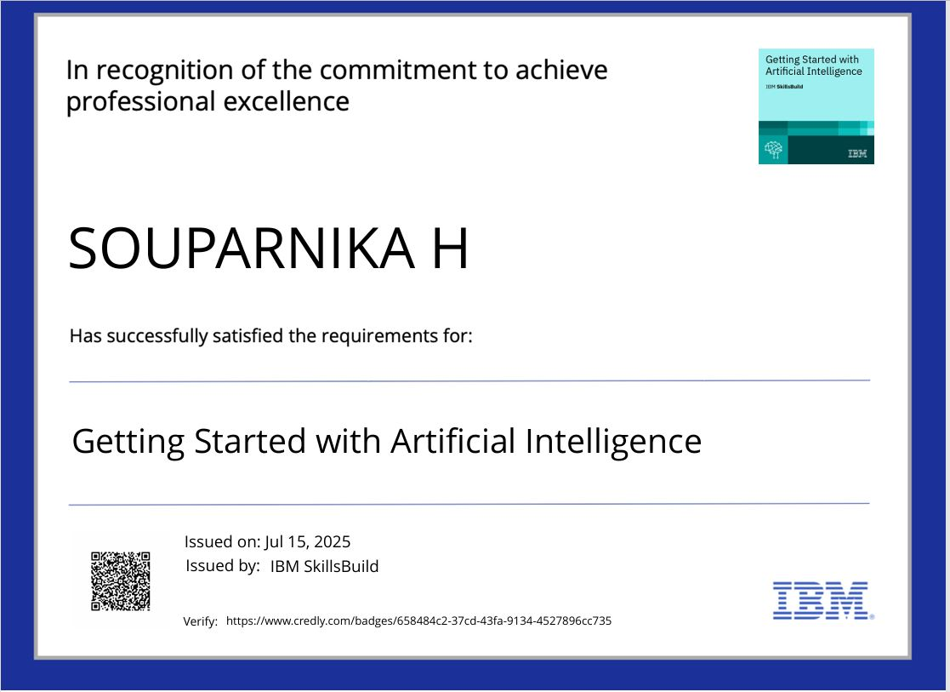
IBM Certifications
Getting Started With Artificial Intelligence

Slide 18
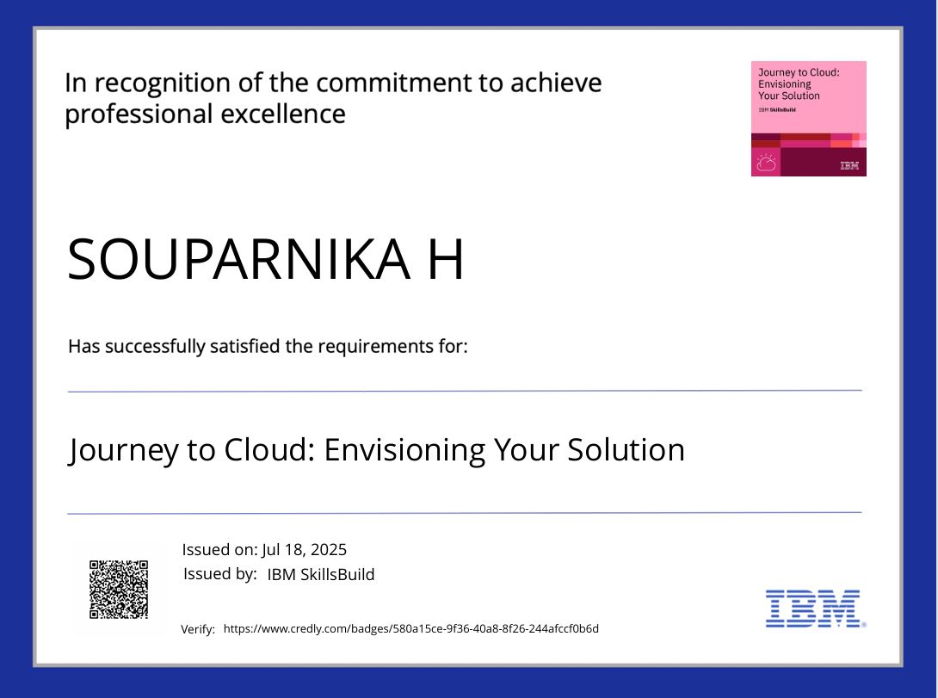
IBM Certifications
Journey to Cloud: Envisioning Your Solution

Slide 19
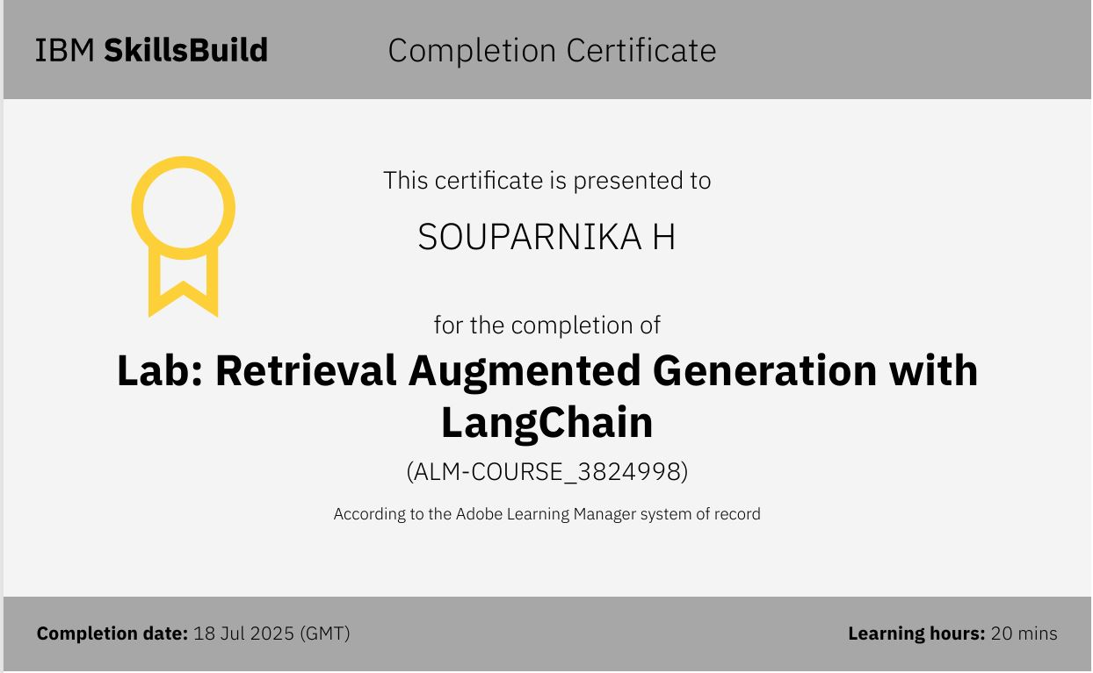
RAG : Retrival Augmented Generation with LangChain

Slide 20
THANK YOU

